Slide 1
Session 3
Creating Innovative Library Spaces
Louise Jones

Slide 2
Evolving LIBRARY SPACES FOR INNOVATION
Louise Jones
@Cuhklibrarian
louisejones@lib.cuhk.edu.hk
Notes:
Ambiguous
Innovation for the library
Supporting innovation in t + learning
Supporting innovation in research

Slide 3
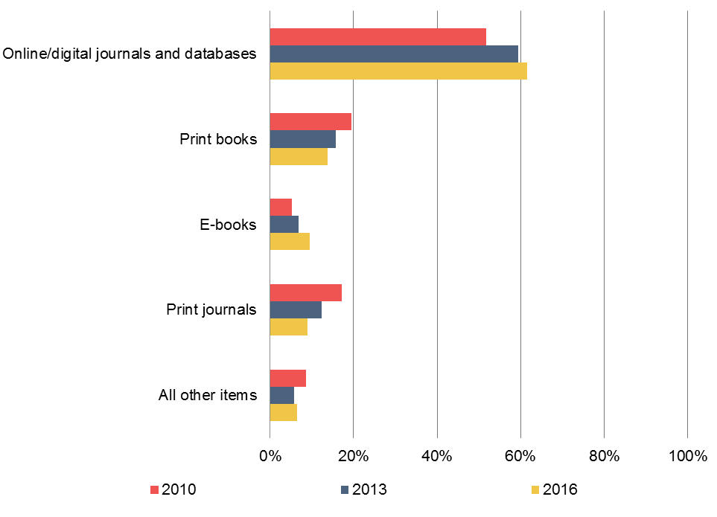
Figure 1: What percentage of your library’s materials budget is spent on the following items? Average estimated percentage of budget spent on each type of item. Ithaka Survey 2016
Notes:
E survey

Slide 4
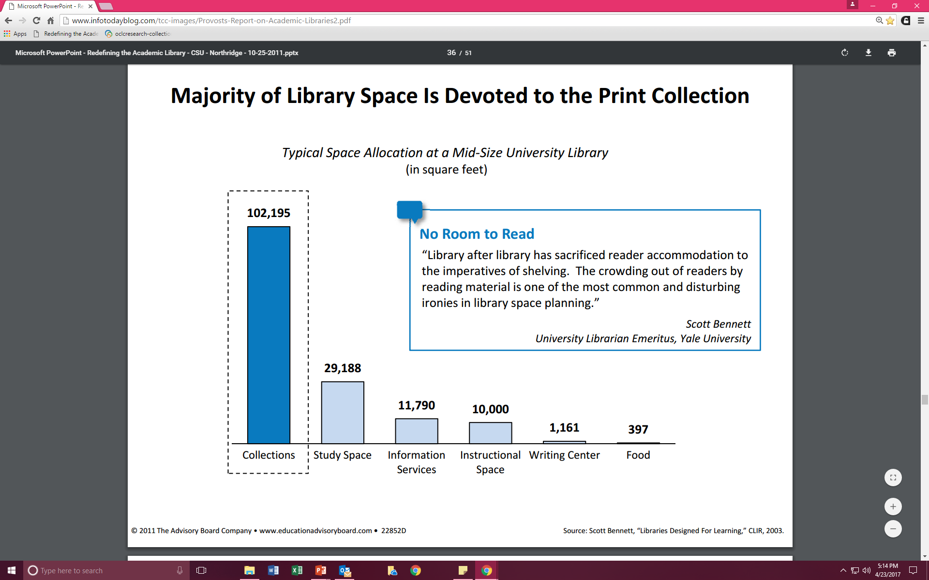
Notes:
2003

Slide 6
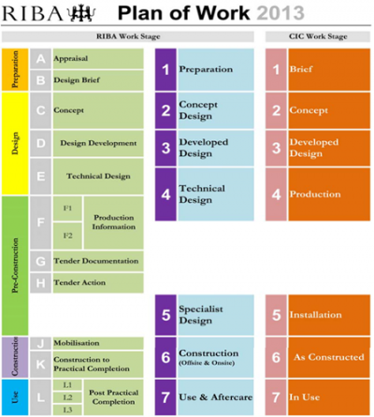

Slide 7
Starting points - ACRL
Institution and Library vision, mission and/or goals statements
Institution and Library strategic plans
Campus master plans
Campus history, culture and demographics
Library needs assessment and environmental scan
Documents from other library projects
Concept documents
Building programs
Architectural plans
Construction budget
Standards
National, regional, and state standards and guidelines for library facilities
Tours of other libraries in construction or recently completed
Library building consultants

Slide 8
Space Planning - ACRL
Changing demographic trends (commuters, residential, distance learners, traditional, non-traditional, etc.)
Relationship between the library and the advancement of the mission of the institution
Relationship between the library and campus
Evolving curricula and pedagogical practices
Service delivery models
Changing role of the library faculty and staff
Understanding the user (academic preparedness, learning preferences, etc.)
Expansive and disruptive technologies
Standards and guidelines
Design for users, collections, and employees

Slide 9
The IMPORTANCE OF GOOD DESIGN
Role of the Architect. From your vision to reality.
Role of the Interior Designer. In parallel with the architect?
Think about
Colour
Flooring
Furniture
Lighting
Acoustics
Accessorizing

Slide 10
CUHK LIBRARY – CASE StUDY
2013 University Library Extension and Redesign
Learning Garden
Research Commons
2015 New Asia Chi’en Mu Library
Boutique Humanities Library Redesign
2016 University Library
Digital Scholarship Lab
Redesign Lobby for self-service
Maker Bubble
2017 Chung Chi Elizabeth Luce Moore Library
Ground Floor redesign for additional study space
2018 United College Library
Conversion of a multimedia library to a humanities library

Slide 11
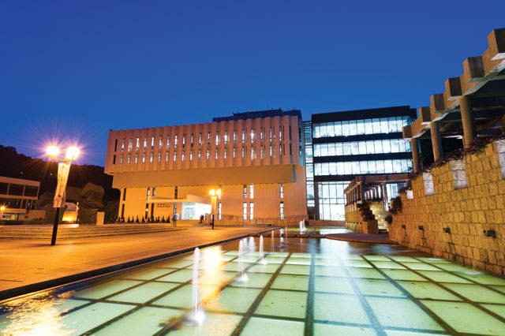

Slide 12
CUHK Drivers for change
Library space constraints
‘3+3+4’ and an increase in student numbers
A new, broader curriculum particularly in the first year
Changing pedagogy
Independent learning
Social/Collaborative learning
Learning in a digital world
Supporting innovation and entrepreneurship
Changing research
Cutting edge research
Interdisciplinarity
Increase in research doctoral students
Referencing new library design in the US and Europe
Design focused on users, not the physical collection
Alignment of library space with the University’s goals

Slide 13
Theoretical framework

Slide 14
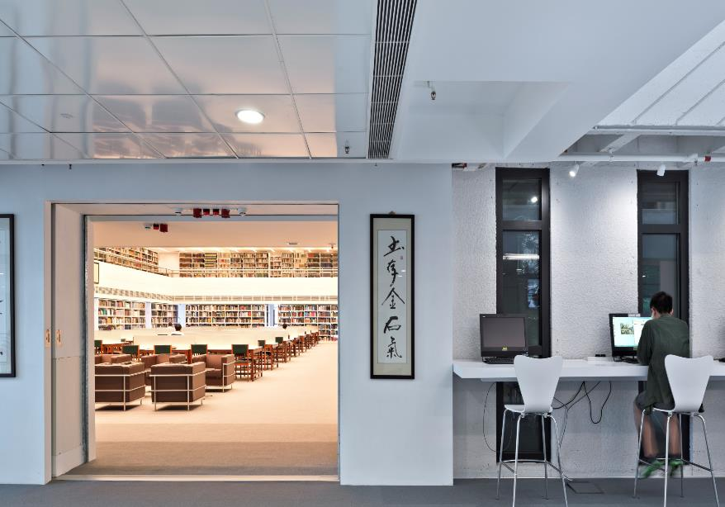
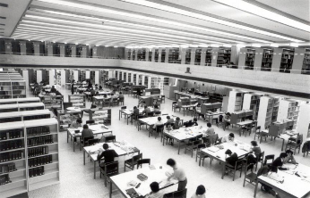

Slide 15
Learning Commons Definition
“The Learning Commons has evolved from a combination library and computer lab into a full-service learning, research and project space.”
(EDUCAUSE, 2011)
NOT a ‘Computer lab with coffee shop’

Slide 16
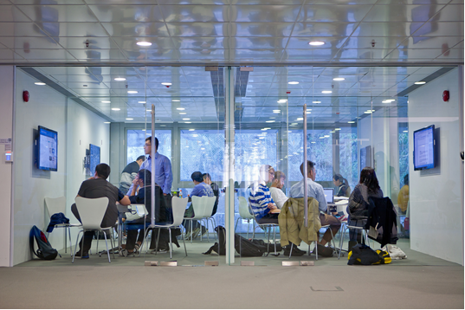

Slide 17
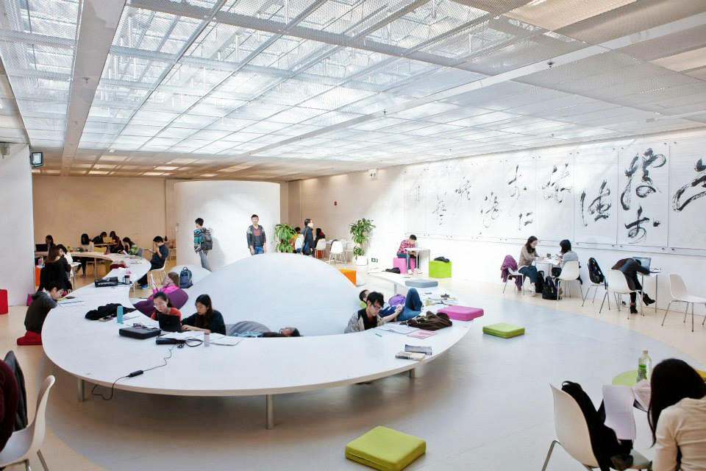

Slide 18
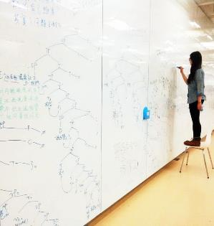
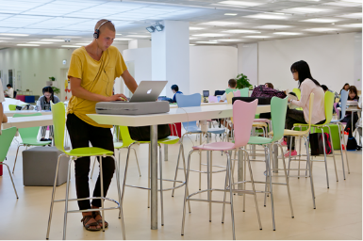
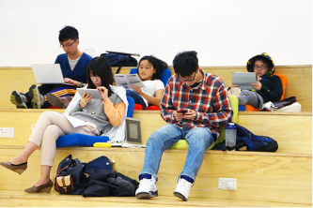
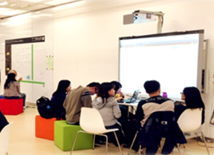
Learner behaviour
Notes:
Spontaneous
IT questions dominate

Slide 19
3D Printing to Maker Space

Slide 20
CUHK Launches Hong Kong’s First University-wide Minor Programme in Entrepreneurship and Innovation Offering Interdisciplinary Learning Experience to All Undergraduate Students
The Chinese University of Hong Kong (CUHK) is introducing a pioneering, university-wide Minor Programme in Entrepreneurship and Innovation (EPIN) in the 2017-18 academic year. The first of its kind in Hong Kong, EPIN is open to all undergraduate students from different faculties and departments. It will act as a platform to nurture creativity, acquire key entrepreneurial attributes and manage innovation processes theoretically and practically, so as to grasp the opportunities brought by various types of technological and social innovations.

Slide 21
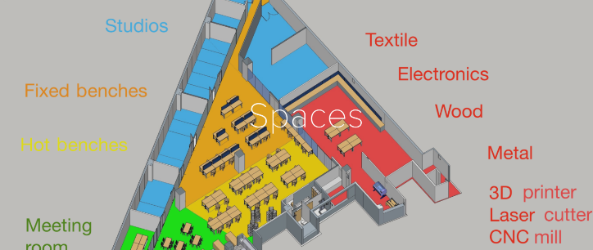

Slide 22
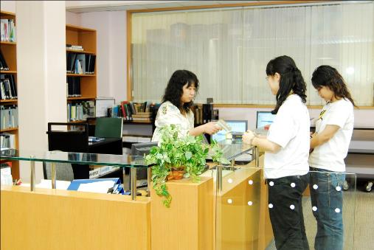
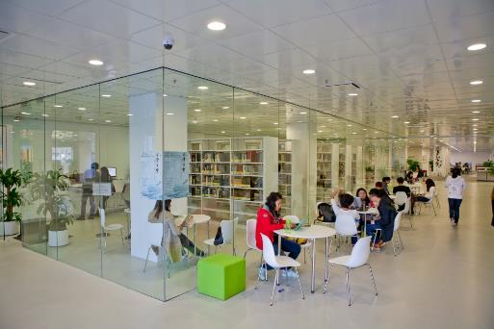
Self Service

Slide 23
EVALUATION - Learner Behaviour Study
Conducted a two-week study in the Learning Garden in Oct 2013
a total of 6,832 occupants and their activities were recorded 395 groups of user were interviewed
81% of users were undergraduates
All Faculties were represented
Average occupants per visit was 207
Maximum occupants per visit was 307
62% of users brought their own computers/electronic devices

Slide 24
Individual & Group activities in the Learning Garden

Slide 25
Types of activities for groups

Slide 26
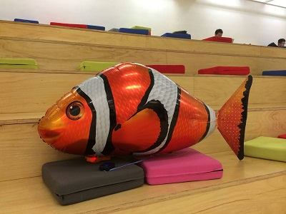
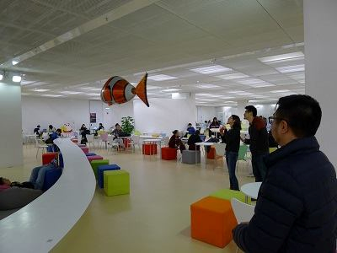
What has the impact been on student learning?
Notes:
Spaces technologies, services, collections staff expertise

Slide 27
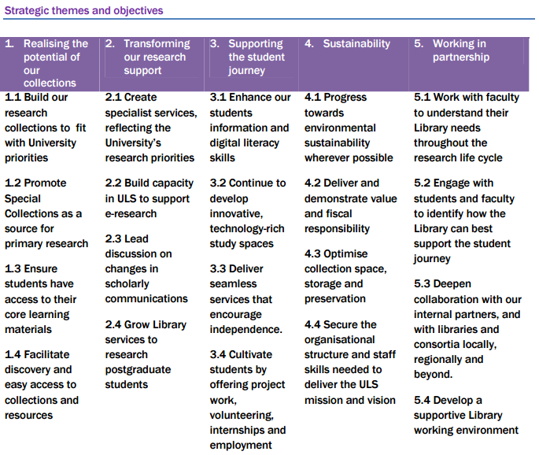
WhY a DigItal SCHOLARSHIP LAB?
“Stop asking if the library has a role, or what it is, and start getting involved in digital projects that are already happening. Advocate for new expanded roles and responsibilities to be able to do this. Become producers / creators in collaboration with scholars rather than servants to them.”

Slide 28
DIGITAL SCHOLARSHIP LAB
Visualization wall with12 x 55” LED TVs combined to make a 5m wide x 2m high video wall
Extremely high resolution - 24,883,200 pixel, best for visualization of large images, exploring big data
1to12 input sources with different layout choices to allow comparison from different sources
Support for various input formats allows users to bring their own mobile devices for connection
80” touch screen LED TV that can be linked to the visualization wall
Power and AV outlets are available on table top for displaying users’ screen to the display wall
Floor Area: ~ 180m²
Seating Capacity: ~ 75
space for collaborative research. Movable tables and chairs for flexibility
Specialist digital scholarship software & tools for GIS, text mining etc.
Tablets and notebooks available for lending upon request
Visualization Room can be used separately / simultaneously with Seminar Room by using partition between the two rooms
Writable partitions have white board for idea generation
Notes:
Opened17 March, 2016

Slide 29
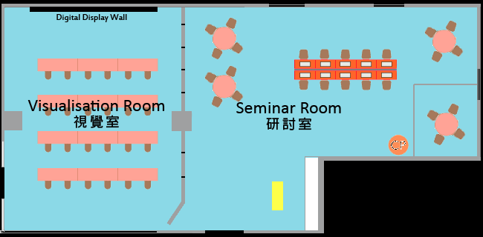
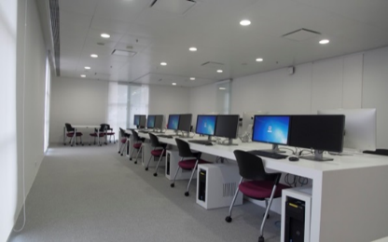
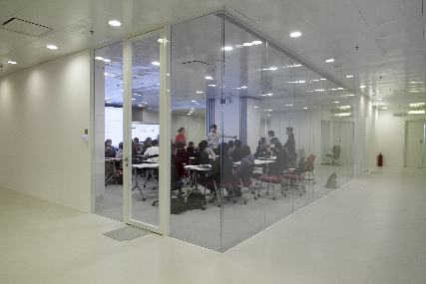
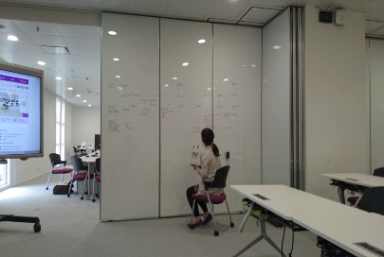

Slide 30
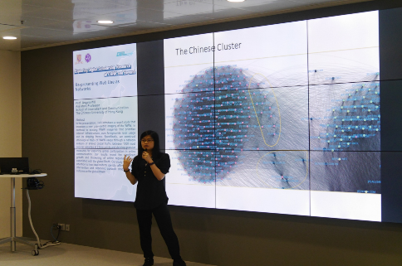
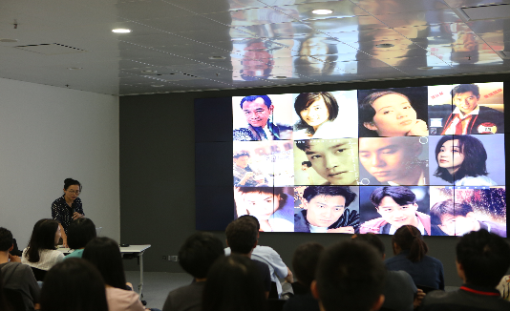
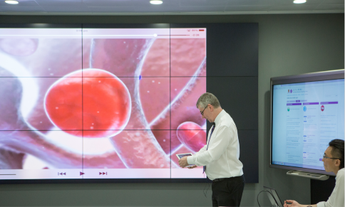

Slide 31
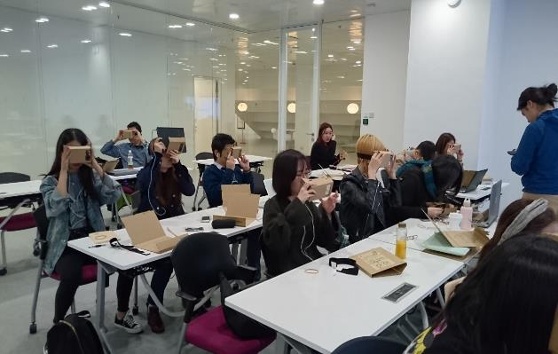
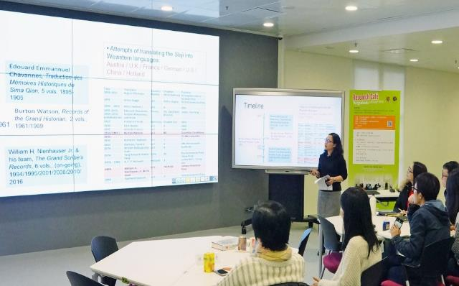

Slide 32
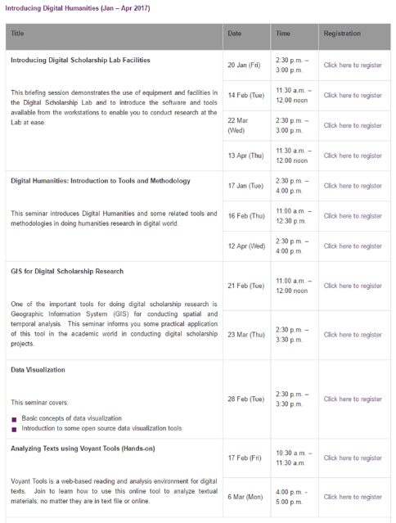
some Success in the past 12 months
A total of 46 events and activities were held for about 1400 participants at the lab: research seminars, conferences, classes, tutorials, and other research-related activities
A total of 26 tours were provided to about 300 visitors including Faculty
A total of 29 library workshops were organized
Partnered with Faculty for some digital scholarship projects

Slide 33
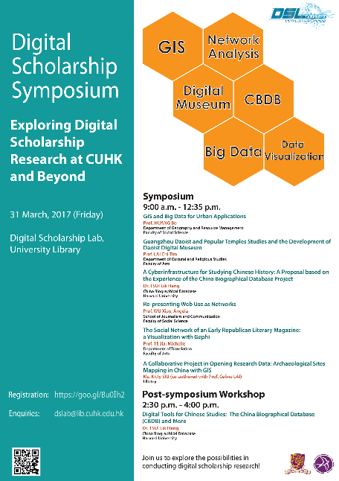
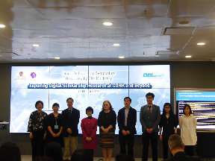
Digital Scholarship Symposium (March 31, 2017)
Organized by the Library
Academics from CUHK and other institutions are invited to share their digital scholarship research and explore the roles of the Library

Slide 34
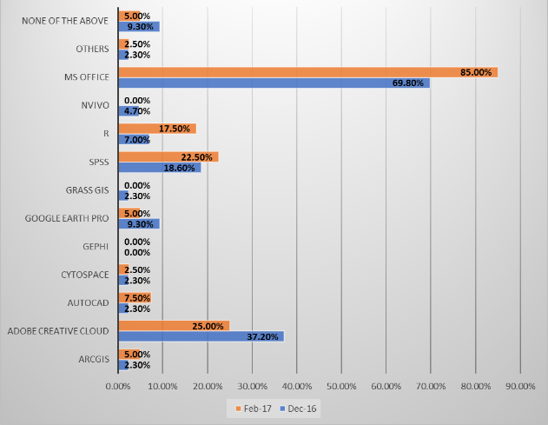
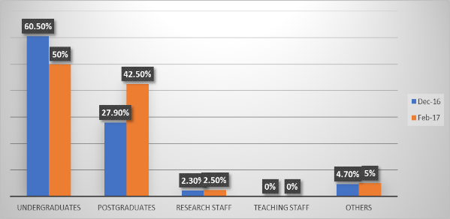
MORE Work to be DONE…
Notes:
2 mini surveys
Two mini-surveys were conducted on the Lab users in Dec 2016 (43 users responded) and February 2017 (40 users responded)
Most users used the lab for general use of the computers and revision / doing assignments
The majority used general software like MS Office and Adobe Creative Cloud

Slide 35
Some CUHK CHALLENGES
Legacy print collections – where do they go?
Stakeholder buy-in
Co-design
How to link learning garden/ DSL/maker bubble
Evolving Library staff roles
Evaluation
Sustainable design

Slide 36
Future Challenges
Virtual sphere
‘Commons as physical spaces will be obliged to integrate even more of the virtual world into the face-to-face environment’
(EDUCAUSE, 2011)
Service delivery for the virtual sphere (Beagle, 2011)
Digital content identification and retrieval
Digital content manipulation and interpretation
Original digital content creation and presentation by students and faculty
Cultural sphere
Appropriate staffing
Collaborative service delivery
Faculty engagement
Notes:
Spaces technologies, mobile, augmented reality
services, collections staff expertise
challenging
Recruiting right staff
Partnerships with Faculty.

Slide 37
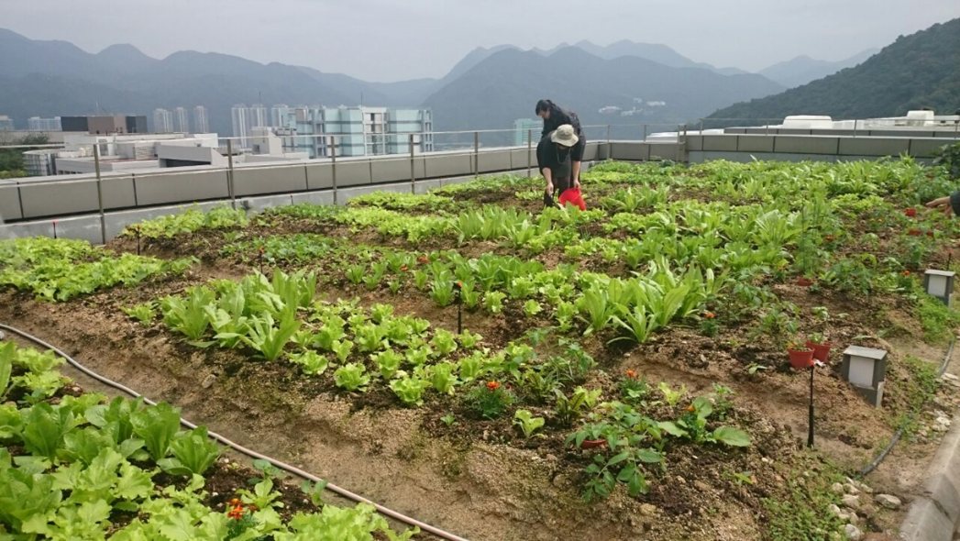

Slide 38
EXERCISE
What are the drivers for innovative library design at your institution? Are there common themes?
Given the drivers what should be the priorities for new library space at your institution? Are there common themes?
What challenges are you facing in designing innovative space? Are there common themes?
How might you start to overcome these challenges? Are there common themes?

Slide 39
READINGS
Beagle, Douglas. From Learning Commons to Learning Outcomes: Assessing Collaborative Services and Spaces. EDUCAUSE Research Bulletin, September 27, 2011. Available from https://library.educause.edu/resources/2011/9/from-learning-commons-to-learning-outcomes-assessing-collaborative-services-and-spaces
Beagle, Douglas. The Research Commons in 2014 and beyond. dh+lib, 30 January 2014
Academic Library Building Design: Resources for Planning. ACRL. http://acrl.libguides.com/
Design thinking for libraries http://designthinkingforlibraries.com/
Designing libraries http://www.designinglibraries.org.uk/
Learning Spaces Guide. JISC. https://www.jisc.ac.uk/guides/learning-spaces
Burke, J. Makerspaces : a practical guide for librarians. Lanham, Rowman & Littlefield 2014.
Video: Joan Lippincott on digital scholarship centers https://www.cni.org/news/video-joan-lippincott-on-digital-scholarship-centers

